Slide 1

HIGHEST PROFIT ASSESSMENT
BY
SEHINDE OLUYEDE
SADA SYSTEMS

Slide 2

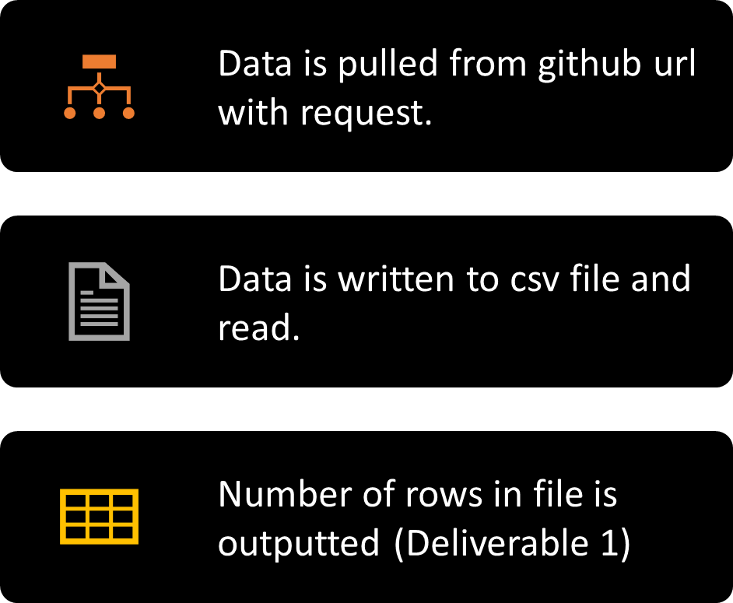
READER

Slide 3
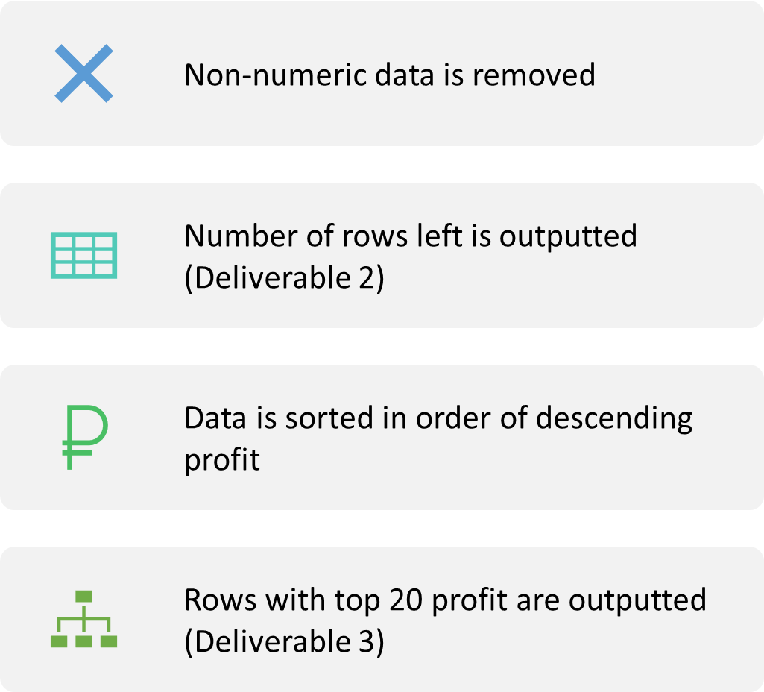
CLEANER

Slide 4
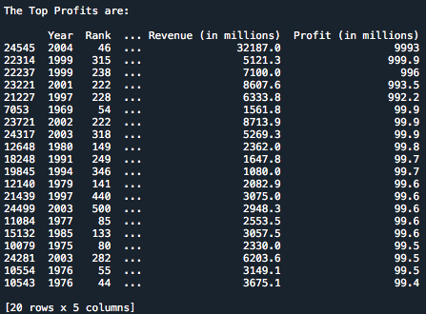
DELIVERABLES
Deliverable 1;
Deliverable 2;
Deliverable 3;

Slide 5
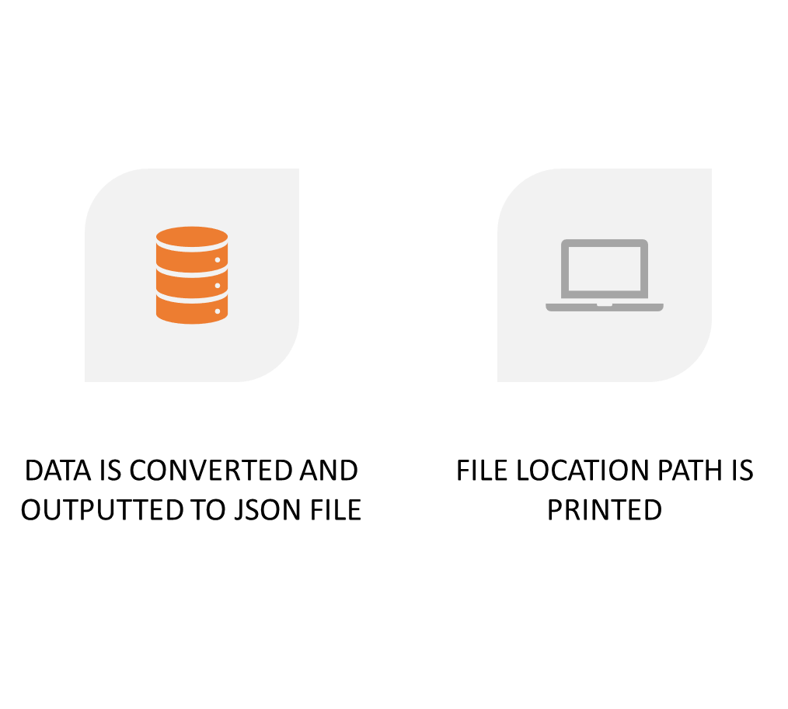
CONVERT TO JSON

Slide 6
SQL METHODOLOGY
SCRIPT:
Let table name = github_data
SELECT count(*) FROM github_data
WITH
clean_data as (
SELECT Year, Rank, Company, Revenue, TRY_CAST(Profit as float) as Profit
FROM github_data),
profit_data as (
SELECT * FROM clean_data
WHERE Profit is not null )
SELECT COUNT(*) FROM profit_data
SELECT * FROM profit_data
ORDER BY clean_profit desc
LIMIT 20
NB:
SQL DOES NOT FUNCTION TO EXPORT JSON FILES, BIG QUERY CAN BE USED FOR THAT

Slide 7
THANKS FOR YOUR TIME

